Slide 1

SERVICE LEARNING PROJECT
BOOK DISTRIBUTION APP
Presented by:
Adhil A - 2062201
Yukeskaanth V - 2062212
Praveen Kumar C - 2062254
Jabersha J - 2062259
Ram Prasath G - 2062615
MISSION
CHRIST is a nurturing ground for an individual’s holistic development to make effective contribution to the society in a dynamic environment
VISION
Excellence and Service
CORE VALUES
Faith in God | Moral Uprightness Love of Fellow Beings
Social Responsibility | Pursuit of Excellence

Slide 2

1A. IDENTIFICATION OF COMMUNITY
CHRIST
Deemed to be University
AVIRATHA TRUST
PoC: Dr. MITHUN BN
Contact number: +91 97396 40366
Address: 73, Vinayaka Layout 3rd Stage, Govindaraja Nagar Ward, Gkw Layout, Vijaya Nagar, Bengaluru, 2nd Main Road, Vinayaka Nagar, Bangalore - 560026 (Map)

Slide 3
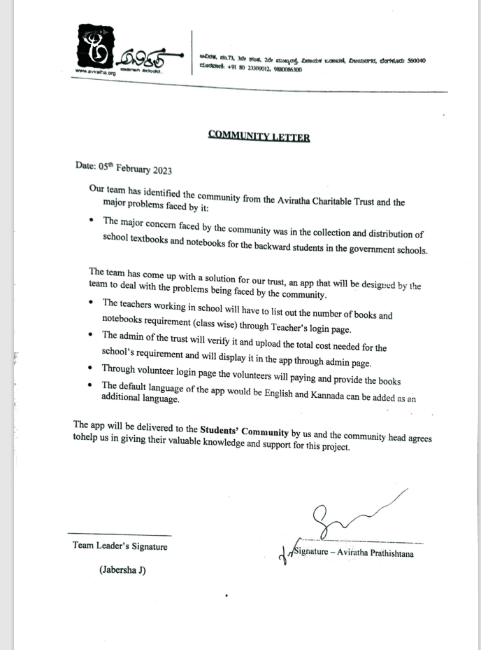
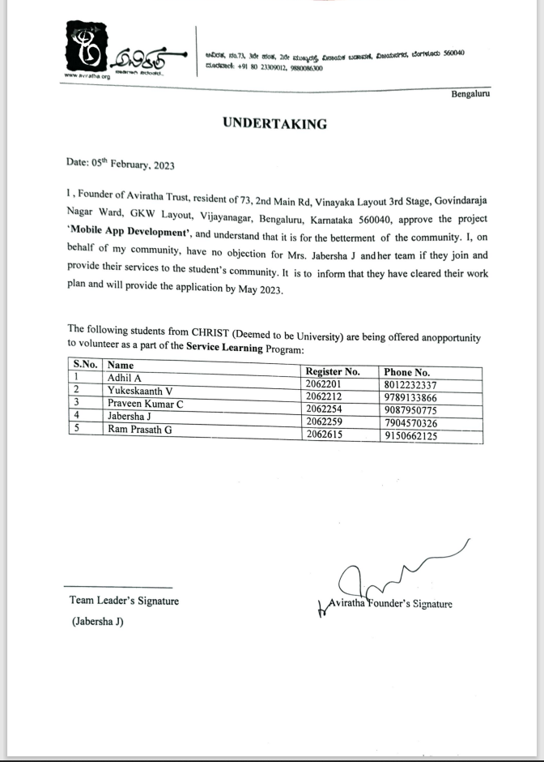
CHRIST
Deemed to be University
COMMUNITY LETTER

Slide 4
Our primary objective is to create an app for book distribution for the schools which will also be handled by the trust (Aviratha) admin and the volunteers who comes under the trust .
CHRIST
Deemed to be University
1B) PROBLEM STATEMENT
The teachers working in school will have to list out the number of books and notebooks required for the students through their login in the app .
The admin of the trust will verify it and upload the total cost needed for the school’s requirement and will display it in the app.
Then the volunteer will raise the fund required to afford the books and donate it to the students of the school

Slide 5
DESIGN DIAGRAMS
MISSION
CHRIST is a nurturing ground for an individual’s holistic development to make effective contribution to the society in a dynamic environment
VISION
Excellence and Service
CORE VALUES
Faith in God | Moral Uprightness Love of Fellow Beings
Social Responsibility | Pursuit of Excellence

Slide 6
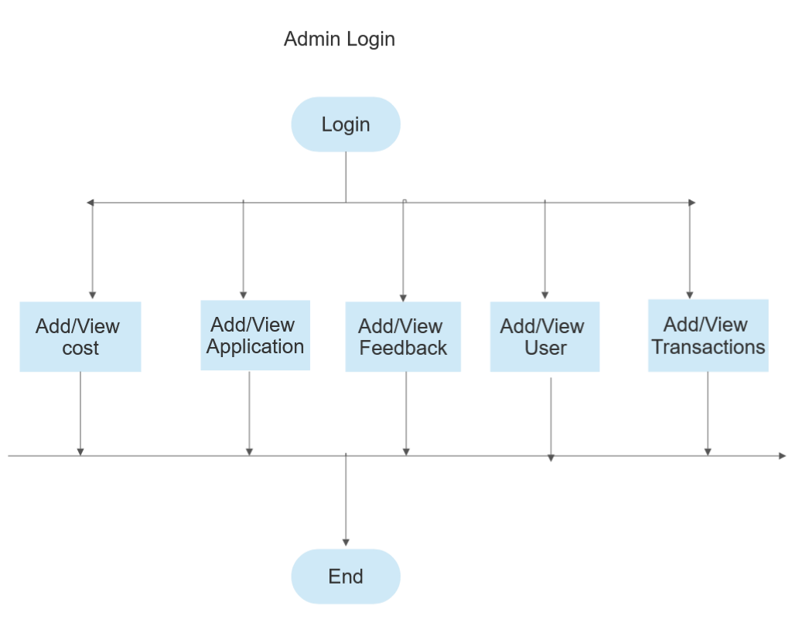
2B) ACTIVITY DIAGRAM
CHRIST
Deemed to be University

Slide 7
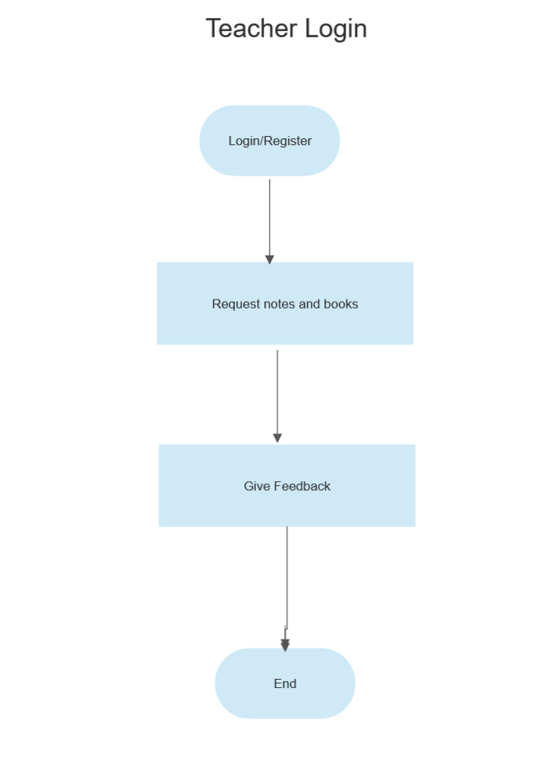

Slide 8
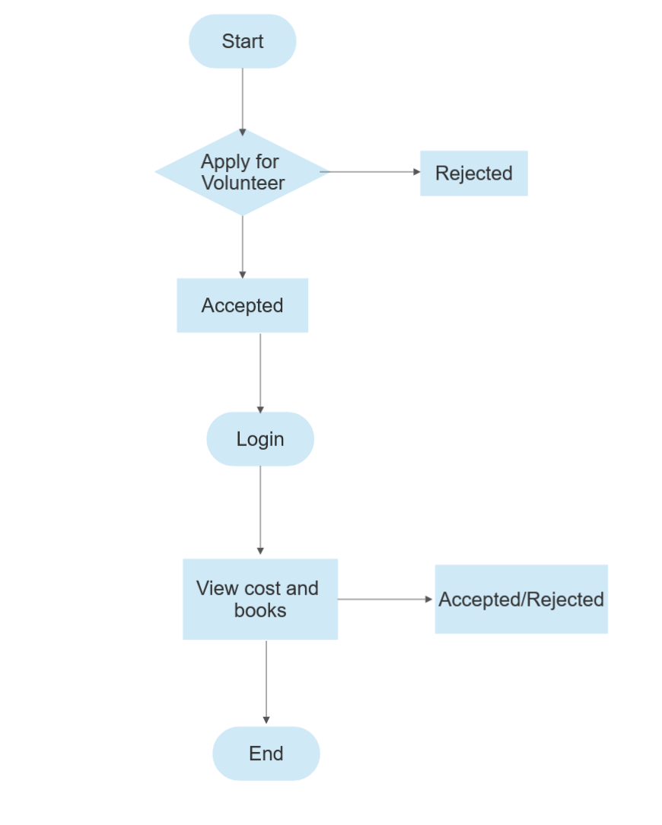
Volunteer login

Slide 9
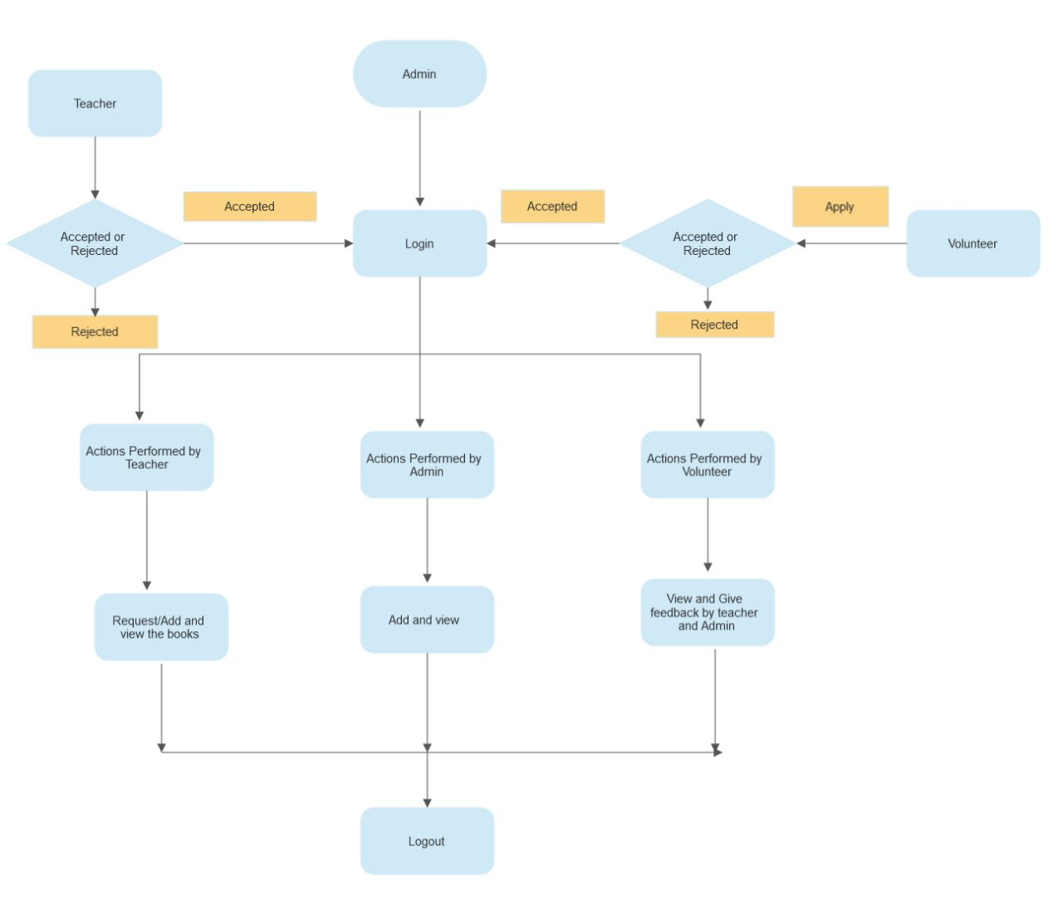
Class diagram

Slide 10
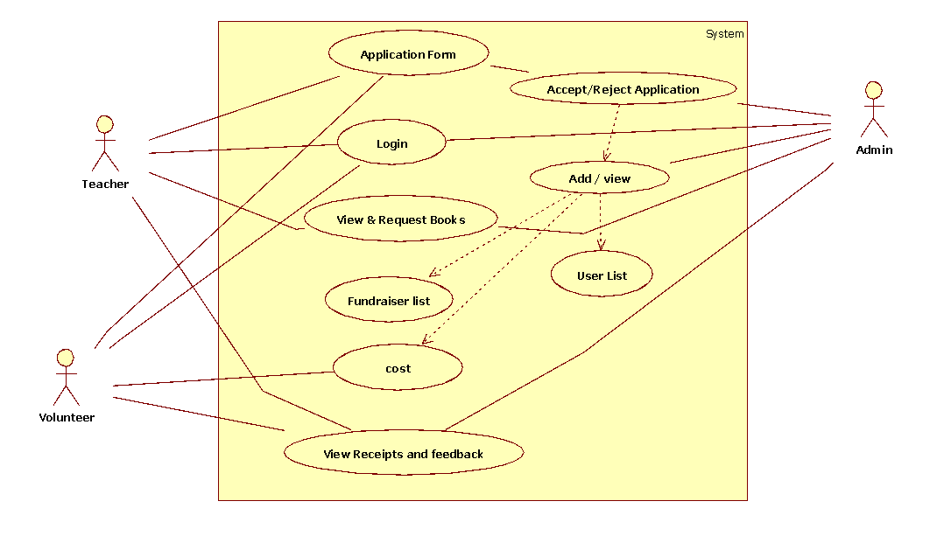
USE-CASE DIAGRAM

Slide 11
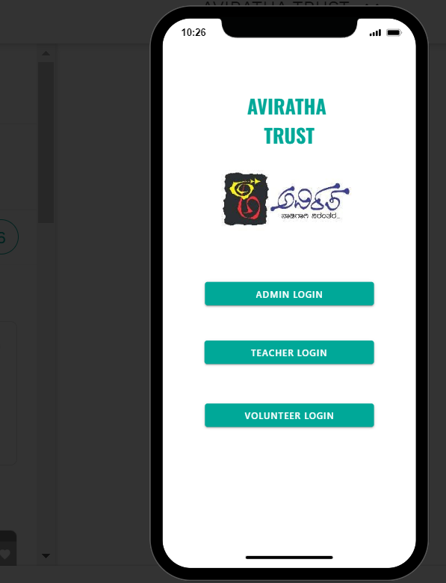
CHRIST
Deemed to be University
PROOF OF CONCEPT
Home page

Slide 12
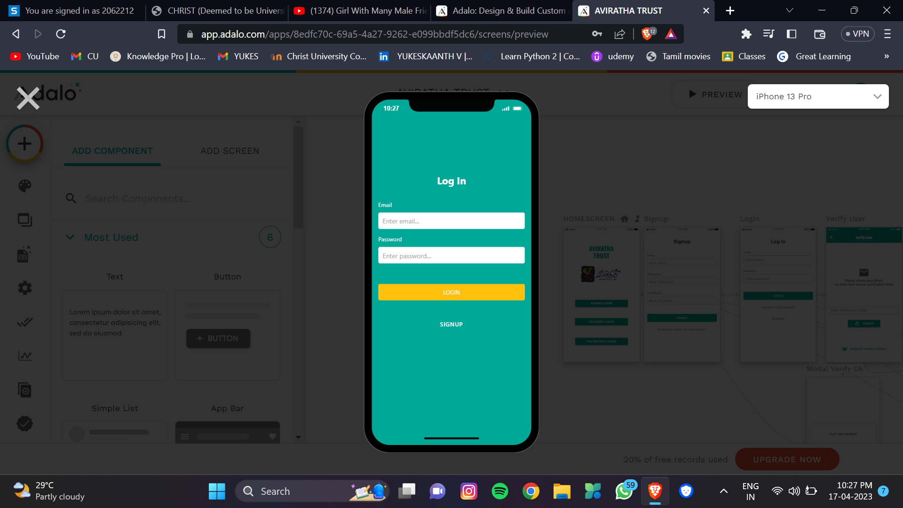
ADMIN LOGIN

Slide 13
VOLUNTEER LOGIN

Slide 14
TEACHER LOGIN

Slide 15
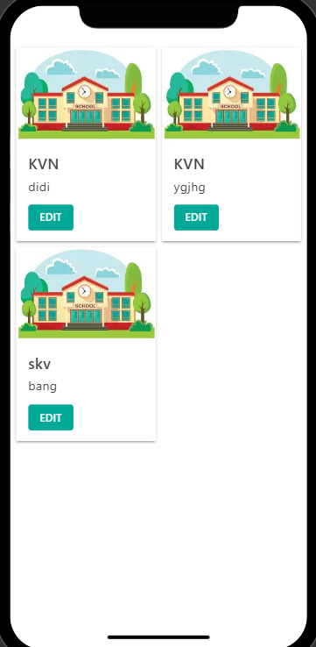
Admin page:

Slide 16
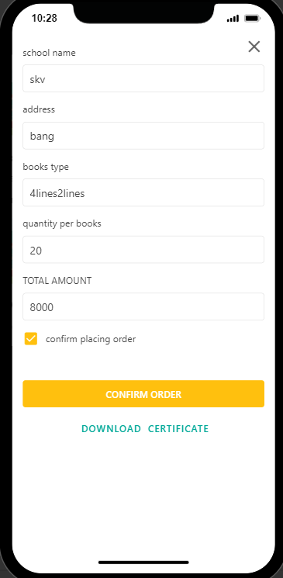
Volunteer page:

Slide 17
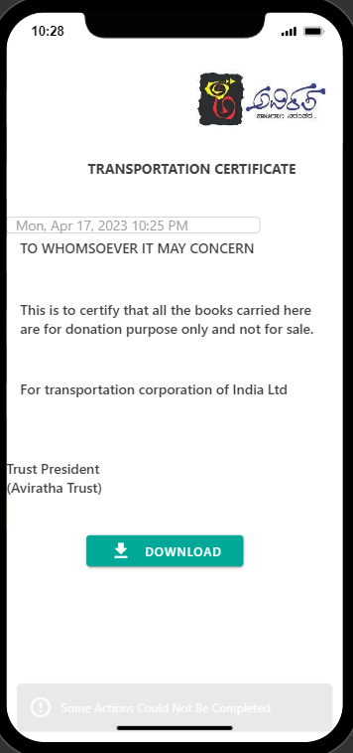
TRANSPORTATION CERTIFICATE

Slide 18
TRANSPORTATION CERTIFICATE

Slide 19
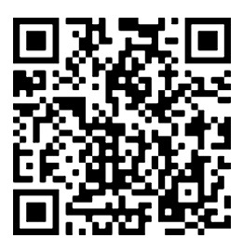
Scan to open the app

Slide 20
THANK YOU!!
CHRIST
Deemed to be University

